Slide 1

DATA SCIENCE
10 WEEK PART TIME COURSE
Super-charging Decision Trees

Slide 2
AGENDA
Decision Tree Regression
Bagging
Ensembling
Random Forest
Boosting
Lab
Other Uses
Discussion

Slide 3
DECISION TREE REGRESSION
DATA SCIENCE PART TIME COURSE

Slide 4
Put content here about tree regression
Lab example is in misc/decision-tree-regression.ipynb

Slide 5
How do we improve decision trees?
DATA SCIENCE PART TIME COURSE

Slide 6
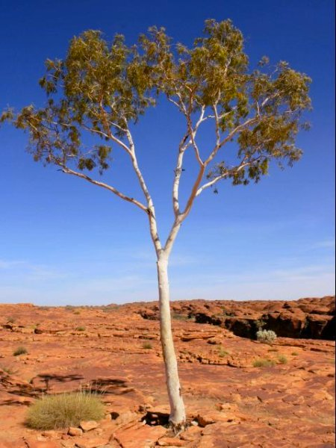
DECISION TREES

Slide 7
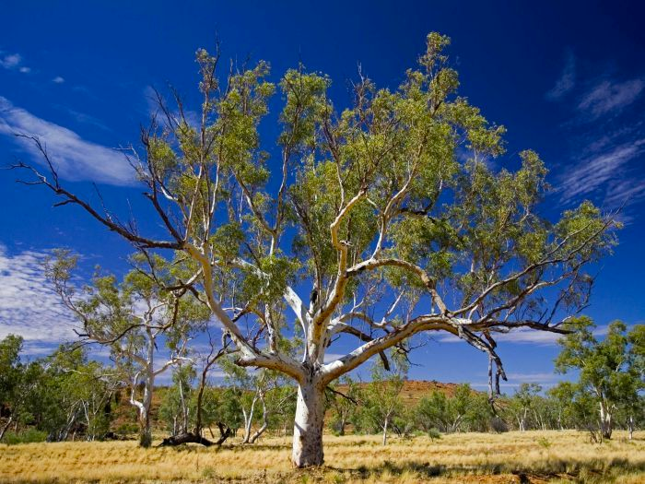
DECISION TREES

Slide 8
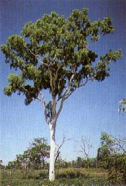
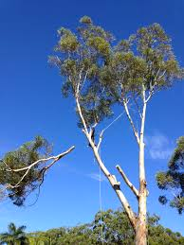
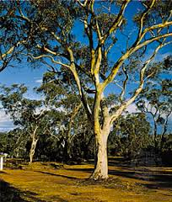
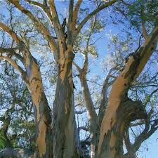
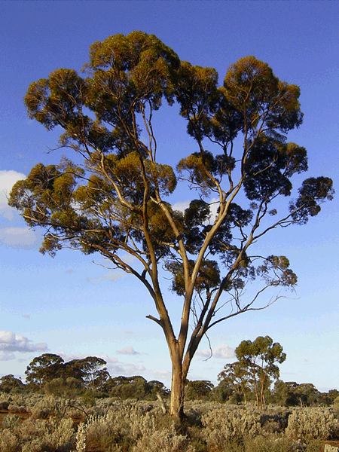
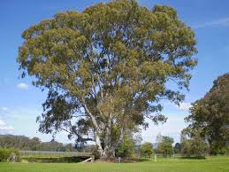
DECISION TREES

Slide 9
BAGGING
DATA SCIENCE PART TIME COURSE

Slide 10
BOOTSTRAP & BAGGING
Bootstrapped Aggregation = Bagging
The bootstrap is a statistical technique that is used to quantify the uncertainty of a model
Bootstrap samples are simply random samples with replacement

Slide 11
BAGGING
What is the bagging process?
Take repeated bootstrap samples (random samples with replacement) from the training data set
Train our method on each bootstrapped training set and make predictions
Average the predictions

Slide 12
BAGGING
This increases predictive accuracy by reducing the variance, similar to how cross-validation reduces the variance associated with the test set approach (for estimating out-of-sample error) by splitting many times an averaging the results.

Slide 13
BAGGING
Specifically to Decision Trees
Grow B regression trees using B bootstrapped training sets
Grow each tree deep enough that each one has low bias
Every tree makes a numeric prediction, and the predictions are averaged (to reduce the variance)
What value should be used for B?

Slide 14
DECISION TREES
HOW DO WE IMPROVE BAGGED DECISION TREES ?

Slide 15
ENSEMBLING
DATA SCIENCE PART TIME COURSE

Slide 16
ENSEMBLE MODELS
Ensemble learning (or "ensembling") is simply the process of combining several models to solve a prediction problem, with the goal of producing a combined model that is more accurate than any individual model.
For classification problems, the combination is often done by majority vote.
For regression problems, the combination is often done by taking an average of the predictions.

Slide 17
ENSEMBLE MODELS - WHEN DO THEY WORK?

Slide 18
ENSEMBLE MODELS - WHEN DO THEY WORK?
For ensembling to work well, the individual models must meet two conditions:
Models should be accurate (they must outperform random guessing)
Models should be independent (their predictions are not correlated with one another)

Slide 19
RANDOM FORESTS
DATA SCIENCE PART TIME COURSE

Slide 20
RANDOM FORESTS
Random Forests is a slight variation of bagged trees that has even better performance! Here's how it works:
Exactly like bagging, we create an ensemble of decision trees using bootstrapped samples of the training set.
However, when building each tree, each time a split is considered, a random sample of m predictors is chosen as split candidates from the full set of p predictors. The split is only allowed to use one of those m predictors.

Slide 21
RANDOM FORESTS
However, when building each tree, each time a split is considered, a
random sample of m predictors
is chosen as split candidates from the
full set of p predictors.
The split is only allowed to use one of those
m predictors.

Slide 22
RANDOM FORESTS
Notes:
A new random sample of predictors is chosen for every single tree at every single split.
For classification, m is typically chosen to be the square root of p. For regression, m is typically chosen to be somewhere between p/3 and p.

Slide 23
RANDOM FORESTS
What's the point?
Suppose there is one very strong predictor in the data set. When using bagged trees, most of the trees will use that predictor as the top split, resulting in an ensemble of similar trees that are "highly correlated".
Averaging highly correlated quantities does not significantly reduce variance (which is the entire goal of bagging).
By randomly leaving out candidate predictors from each split, Random Forests "decorrelates" the trees, such that the averaging process can reduce the variance of the resulting model.

Slide 24
VARIABLE IMPORTANCE
Although bagging increases predictive accuracy, it decreases model interpretability because it's no longer possible to visualize the tree to understand the importance of each variable.
To compute variable importance for bagged regression trees, we can calculate the total amount that the mean squared error is decreased due to splits over a given predictor, averaged over all trees.
A similar process is used for bagged classification trees, except we use the Gini index instead of the mean squared error.

Slide 25
OUT-OF-BAG ERROR
Bagged models have a very nice property: out-of-sample error can be estimated without using the test set approach or cross-validation. How it works:
On average, each bagged tree uses about two-thirds of the observations. For each tree, the remaining observations are called "out-of-bag" observations.
For the first observation in the training data, predict its response using only the trees in which that observation was out-of-bag. Average those predictions (for regression) or take a majority vote (for classification).
Repeat this process for every observation in the training data.
Compare all predictions to the actual responses in order to compute a mean squared error or classification error. This is known as the out-of-bag error.

Slide 26
DECISION TREES
WHAT ELSE COULD WE DO TO IMPROVE DECISION TREES ?

Slide 27
BOOSTING
DATA SCIENCE PART TIME COURSE

Slide 28
BOOSTING
Boosting involves the base learners being built sequentially (using previous models). The aim is to reduce the bias of the combined estimator.
Compare this to something like bagging where the models are built independently of one and other.

Slide 29
ADABOOST - ADAPTIVE BOOSTING
AdaBoost works by building sequential models on re-weighted versions of the data. Initially all data points have the same weighting = 1/N.
After the first model the error on the points is evaluated and the weighting for each observation is adjusted. So if we fit a model and an observation has a large difference between the observed and predicted we give that observation a higher weighting and run the model again.
This means observations that are difficult to predict become more influential in the model.

Slide 30
GRADIENT BOOSTING
Gradient Boosting is a technique that are sequentially fitted that minimise a loss function. For regression this might be the square loss. So we would be updating the model based on Gradient Descent.
This differs to AdaBoost where the boosting was performed by re-weighting the original observations.

Slide 31
eXtreme Gradient Boosting
XGBoost is an optimized distributed gradient boosting library designed to be highly efficient, flexible and portable. It implements machine learning algorithms under the Gradient Boosting framework. XGBoost provides a parallel tree boosting(also known as GBDT, GBM) that solve many data science problems in a fast and accurate way. The same code runs on major distributed environment(Hadoop, SGE, MPI) and can solve problems beyond billions of examples.
- https://github.com/dmlc/xgboost

Slide 32
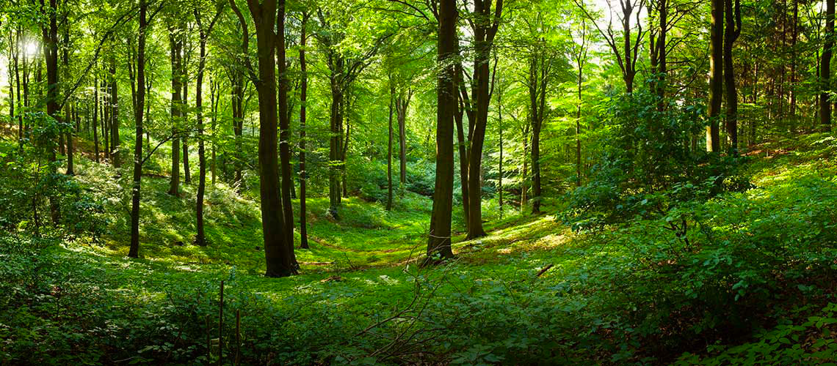
LAB
DATA SCIENCE PART TIME COURSE

Slide 33
OTHER USES
DATA SCIENCE PART TIME COURSE

Slide 34
RANDOM FOREST FOR CLUSTERING
The idea is to create Synthetic data (fake data that is based on the original data set)
Then combine this fake data with your original data set
Assign a ‘Synthetic_data’ with 1 for the synthetic data and 0 for real data
Run the Random Forest model trying to predict ‘Synthetic_data’
You will have a ‘distance metric’ or ‘proximity’ which is basically how many times the samples occur in the same terminal nodes.

Slide 35
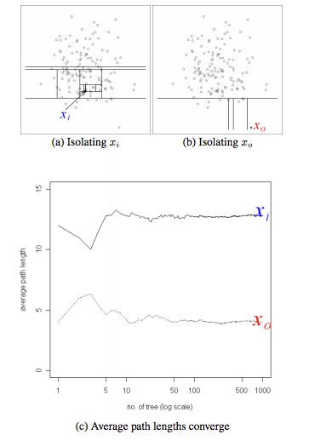
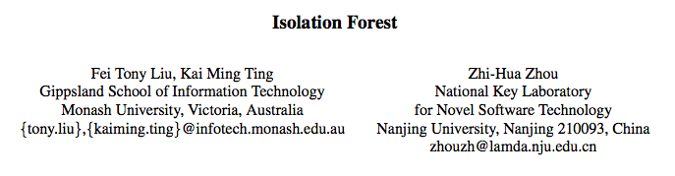
ISOLATION FOREST FOR OUTLIER DETECTION

Slide 36
RULEFIT = RANDOM FOREST + ELASTIC NET
Extract all the rules from all the trees and use them as features in an elastic net model.
Nice way to build a simpler more interpretable model

Slide 37
DISCUSSION TIME
DATA SCIENCE - Week 7 Day 2

